Slide 1
AQA
A Level
Computer Science
Paper 1
Trees
Unit 7
Data structures

Slide 2
Objectives
Know that a tree is a connected, undirected graph with no cycles
Know that a binary tree is a rooted tree in which each node has at most two children
Be familiar with typical uses for rooted trees

Slide 3
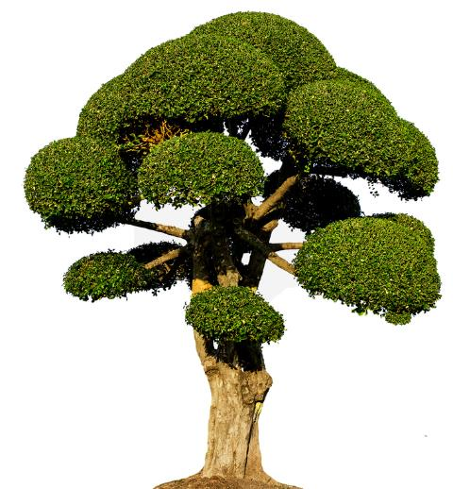
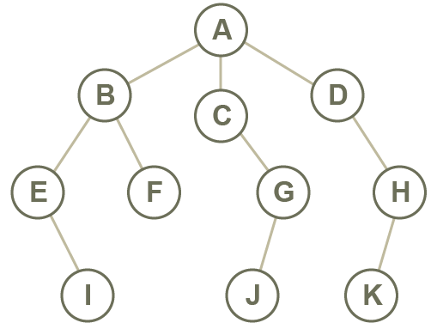
Abstraction
A tree is a common abstract data type (ADT)
Like a tree in nature, a tree data structure has a root, branches and leaves
The difference is that a tree in computer science has its root at the top

Slide 4
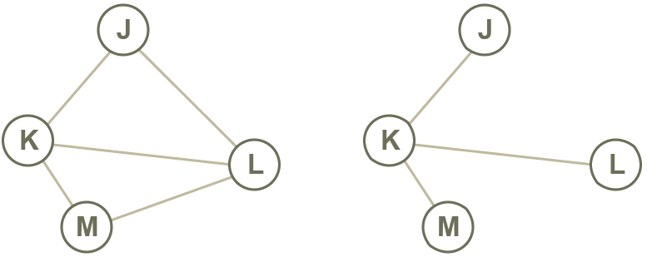
Definition of a tree
A tree is a connected, undirected graph with no cycles (i.e. there is a unique path from each node to any other node)
Does either of the following diagrams represent a tree?

Slide 5
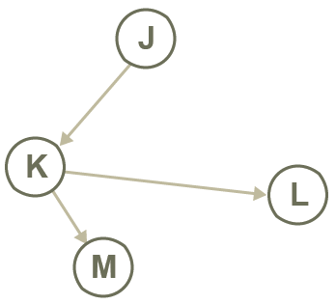
A rooted tree
In a rooted tree, one node is identified as the root
Every node except the root has one unique parent
Does the following diagram represent a rooted tree?
If so, which node is the root?

Slide 6
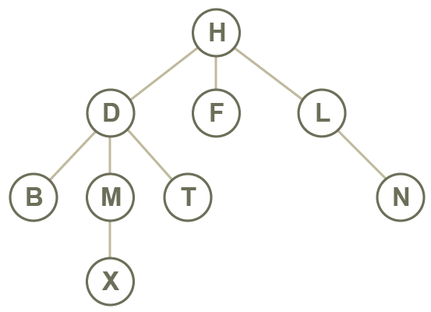
Rooted tree
Terminology:
Node
Edge
Root
Child
Parent
Subtree
Leaf

Slide 7
Worksheet 5
Try Task 1 on the worksheet

Slide 8
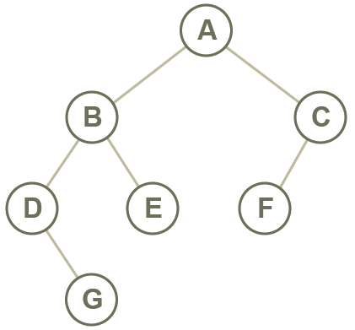
Binary tree
A binary tree is a rooted tree in which each node has a maximum of two children

Slide 9
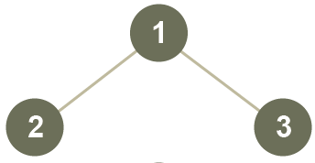
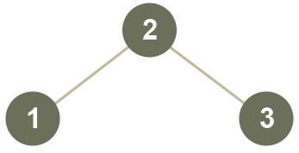
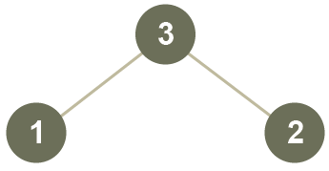
Traversing a binary tree
A binary tree can be traversed in three different ways:
Pre-order: Visit the root, then traverse the left sub-tree, then the right sub-tree
In-order: Traverse the left sub-tree, then visit the root, then traverse the right sub-tree
Post-order: traverse the left sub-tree, then traverse the right sub-tree, then visit the root

Slide 10
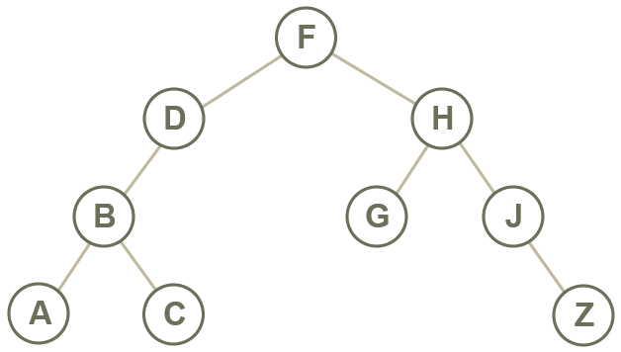
Tree traversals
In-order, pre-order and post-order refer to when the root is visited
If the node is the root of a subtree, traverse the subtree first

Slide 11
Traversing a tree
What order are the nodes visited in with a
Pre-order traversal
In-order traversal
Post-order traversal?

Slide 12
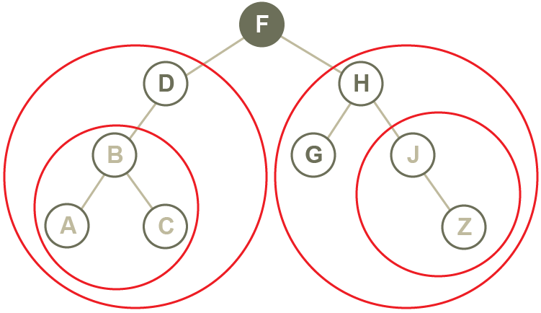
Traversing a tree
Pre-order traversal: F, D ,B, A, C, H, G, J, Z
In-order traversal: A, B, C, D, F, G, H, J, Z
Post-order traversal: A, C, B, D, G, Z, J, H, F

Slide 13
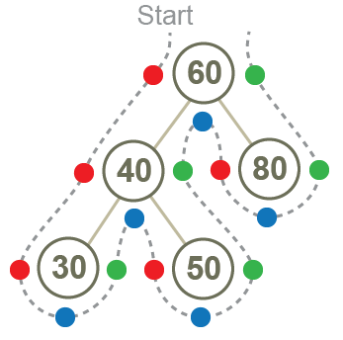
Binary tree traversals
Pre-order
In-order
Post-order

Slide 14
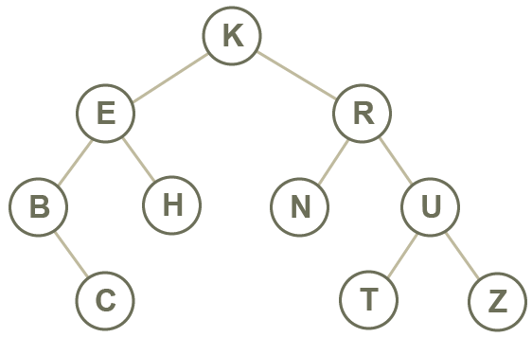
Binary search trees
A binary search tree holds items in such a way that the tree can be searched quickly and easily for a particular item
Which traversal is used to visit each node in alphabetic sequence?

Slide 15
Building a binary search tree
Nodes are added in the order given, with the first item at the root
Starting at the root each time, if the next item is less than the root, it is added to the left of the root, otherwise, to the right
Apply the same rule at the root of each sub-tree
Draw each stage of the binary tree with nodes:
12, 7, 18, 22, 14, 10, 56, 3, 6, 20, 8

Slide 16
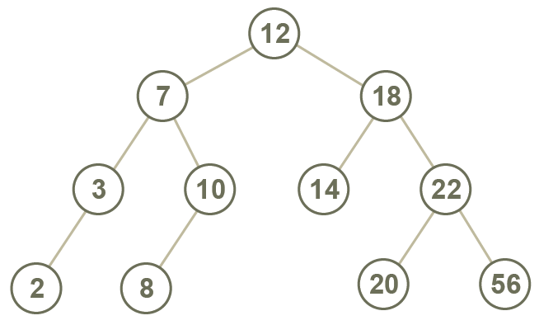
Building a binary search tree
Draw each stage of the binary tree with nodes:
12, 7, 18, 22, 14, 10, 56, 3, 2, 20, 8

Slide 17
Worksheet 6
Complete Task 2 on the worksheet

Slide 18
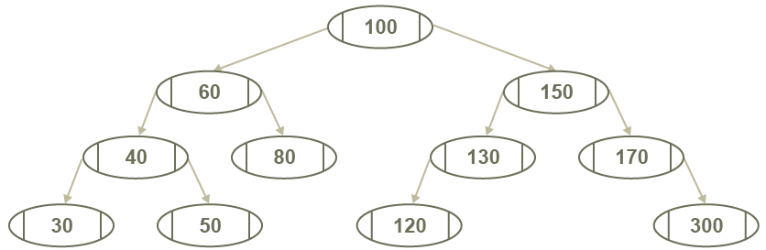
A balanced binary tree
A balanced tree is one where the nodes are distributed in such a way that the height is kept to a minimum
This allows more efficient searching

Slide 19
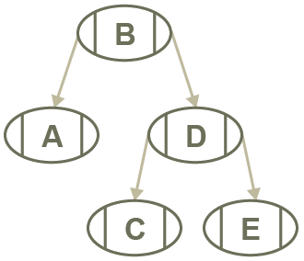
Implementing a binary tree
Each node consists of 3 parts
The data (which may be a primitive or more complex object)
A left pointer to a child
A right pointer to a child

Slide 20
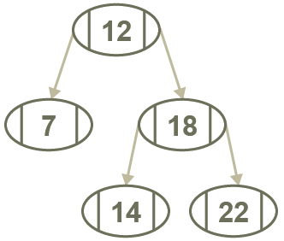
Binary tree – arrays
A binary tree may be represented as an array of records, or a two-dimensional list
Suppose items are added to a binary tree in the order:
[0] [1] [2] [3] [4]
12 7 18 14 22
A pointer of -1 indicates that there is no subtree on that side
Can you find an error in this representation of the tree?
 | left | data | right
A[0] | 1 | 12 | 2
A[1] | -1 | 7 | -1
A[2] | 3 | 18 | 4
A[3] | 4 | 14 | -1
A[4] | -1 | 22 | -1

Slide 21
Worksheet 6
Complete Task 3 on the worksheet

Slide 22
Plenary
What properties must a graph have for it to be a tree?
Discuss the validity of the following statement:
“Every node in a tree is a root node”
Suggest reasons why data might be organised into a tree ADT
Describe the different types of binary tree traversal

